Slide 1


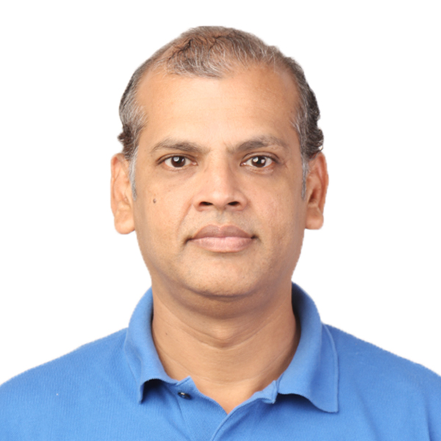
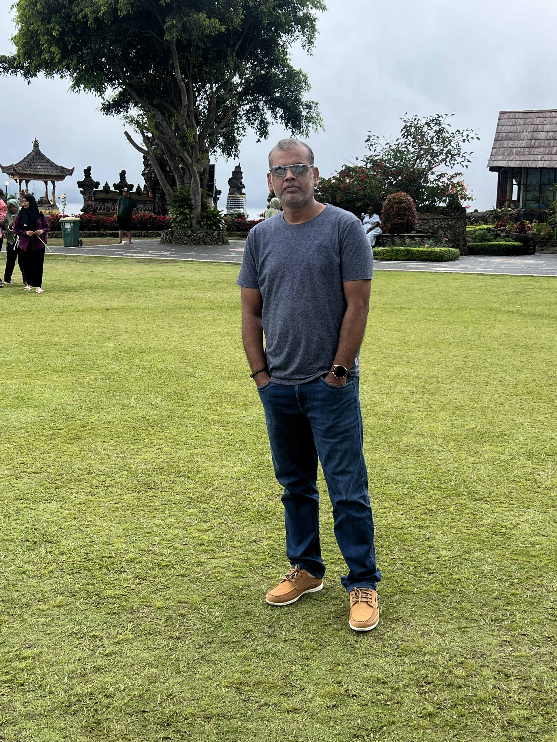
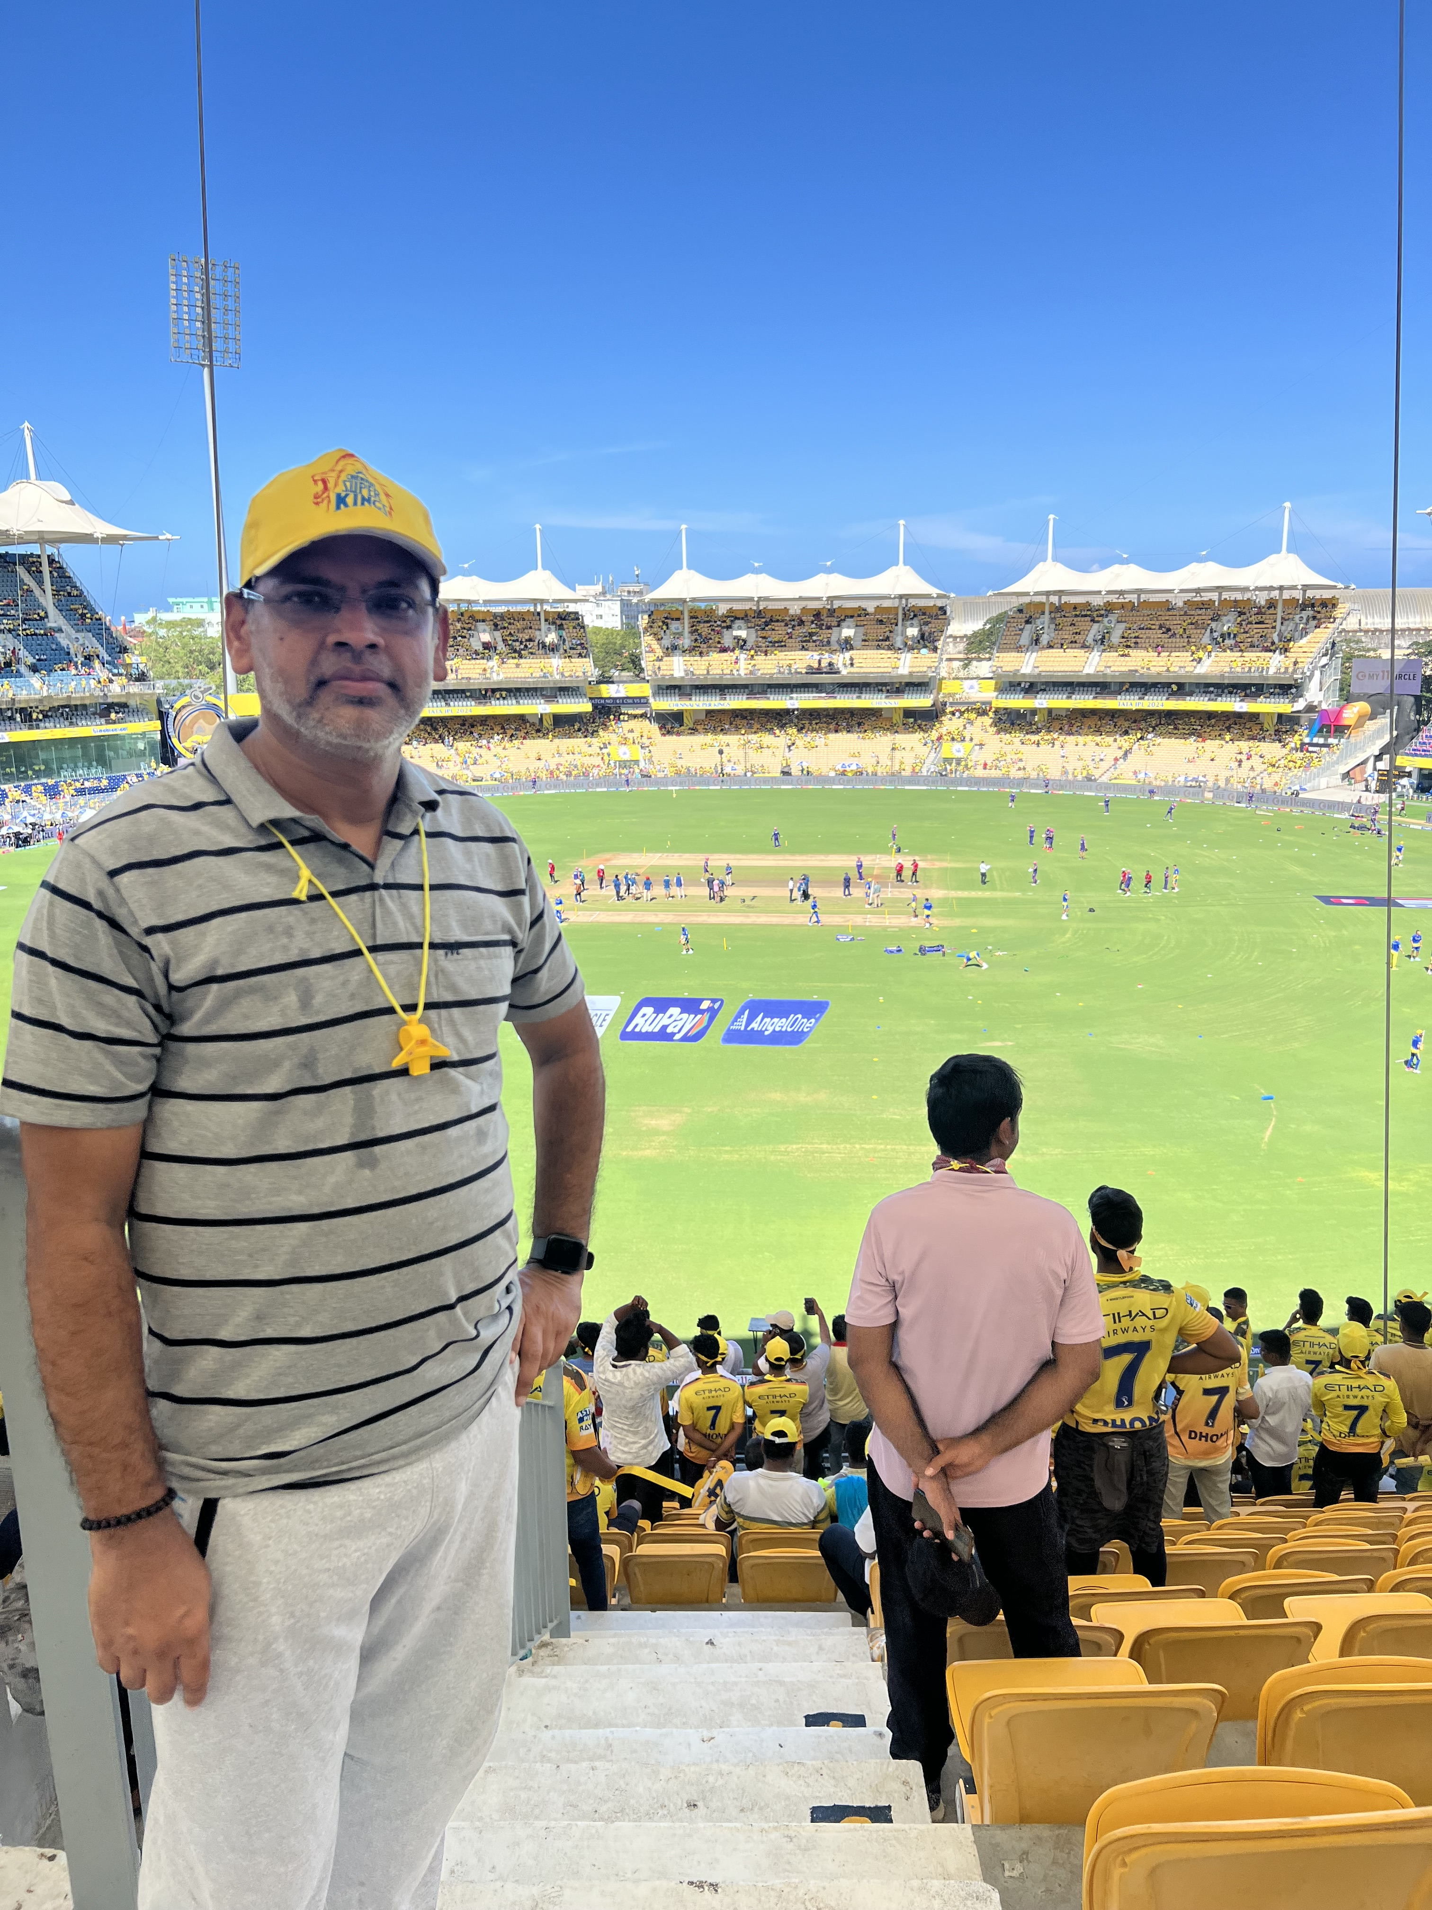
Getting to Know Me
Work
Personal
My role
Finance manager
Significant others / family members / furry friends in my life
Mom / wife and kids & finally great friends
Tenure in ofi/Olam
13 yers
How I enjoy spending my free time
travel/ books / sports
Previous companies I have worked at
Deekay group
My favorite / comfort food
Authentic south Indian veg food
Why I joined ofi/Olam and what keeps me here?
Because of strong global presence,diverse operations and clear impact across agricultural value chain.
My favorite song
Show me the meaning of being lonely – back street boys.
Rangarajan Thambuswamy
‘Ranga’
A few fun facts about me
Avid Cricket and Lawn tennis follower ( especially Djokovic)
This is me outside work, doing stuff I enjoy in my life …

